Slide 1

SPELL CHECKER
Prince Jain
Mino Won
Sriharsha Vasadi

Slide 2
Index
Introduction
Motivation
Algorithm
Approach
Results expectation
Milestones
Risk assessment

Slide 3
Introduction: SPELL CHECKER
Given a input, SPELL CHECKER gives the first 5 best matched words
Algorithm : DTW (Dynamic Time Warping)

Slide 4
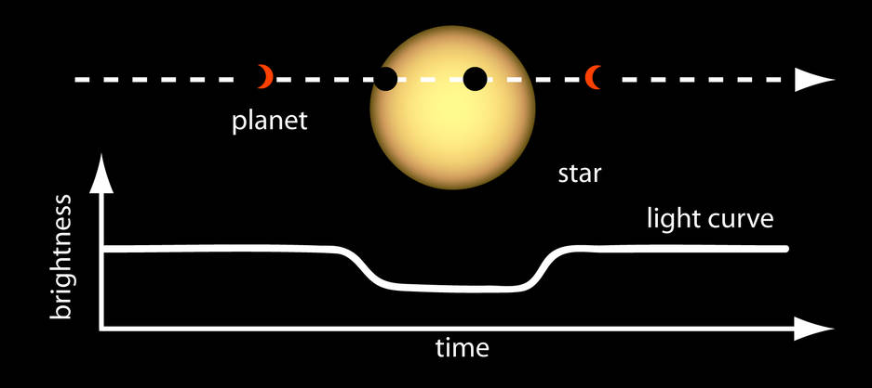

Motivation/Applications
Any Data Mining problem that can be turned into a linear sequence
Astronomical Observations
Speech Recognition

Slide 5
SPELL CHECKER
Match Input string with the templates(Dictonary)
Example:
Input : P U B L I K P U B L I K
Template : P U B L I C P E O P L E
Source: http://www.cs.cmu.edu/~bhiksha/courses/11-756.asr/spring2011/

Slide 6
String Comparison
3 types of error
Substitution
P U B L I K
P U B L I C
Insertion
P O T A T O E
P O T A T O
Deletion
A G R E
A G R E E
Source: http://www.cs.cmu.edu/~bhiksha/courses/11-756.asr/spring2011/

Slide 7
String Comparison
Why did we pick the above alignments? Why not some other alignment:
A G R E vs A G R E
A G R E E A G R E E
What is the metric to get the best alignment?
Source: http://www.cs.cmu.edu/~bhiksha/courses/11-756.asr/spring2011/

Slide 8
String Comparison
Metric/Cost to decide the best match
Edit distance: the minimum number of editing operations needed to convert one into the other
Editing operations: substitutions, insertions, deletions
Source: http://www.cs.cmu.edu/~bhiksha/courses/11-756.asr/spring2011/

Slide 9
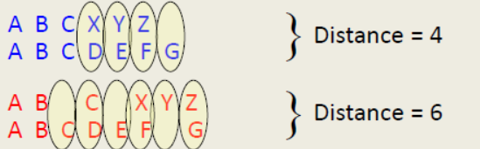
String Comparison
Need an Algorithm to automate the computation the minimum edit distance
Source: http://www.cs.cmu.edu/~bhiksha/courses/11-756.asr/spring2011/

Slide 10
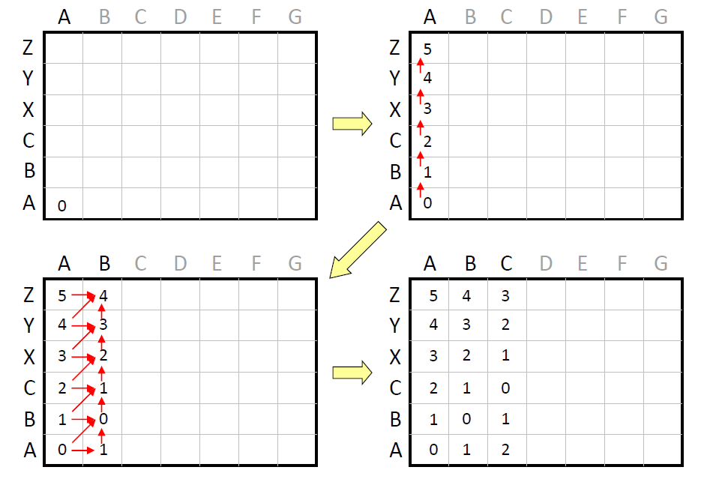
String Comparison
Dynamic Programming(DP):
Compute the edit distance by incrementally comparing substrings of increasing length
Source: http://www.cs.cmu.edu/~bhiksha/courses/11-756.asr/spring2011/

Slide 11

String Comparison
Dynamic Programming(DP):
Optimal path to any intermediate point X in the matrix in terms of optimal paths of all its immediate predecessors
Let $M_{X}$ = Min. path cost from origin to any point X in matrix
Source: http://www.cs.cmu.edu/~bhiksha/courses/11-756.asr/spring2011/

Slide 12
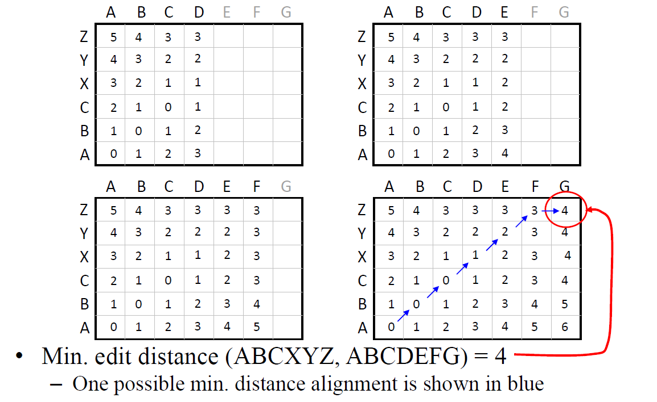
String Comparison
Minimum edit distance
= Value at top right corner
2D Matrix is called Trellis
Source: http://www.cs.cmu.edu/~bhiksha/courses/11-756.asr/spring2011/

Slide 13
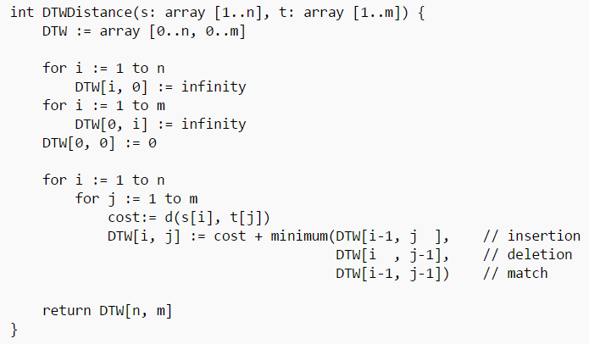
Algorithm

Slide 14
String Comparison
Computational Cost = String-length(template) x String-length(input) x 3
Memory Cost = String-length(template) x 2
We don’t need to store the entire matrix(Trellis) to compute min. edit distance
Since each column depends on previous, we only need storage for 2 columns: current & previous
Source: http://www.cs.cmu.edu/~bhiksha/courses/11-756.asr/spring2011/

Slide 15
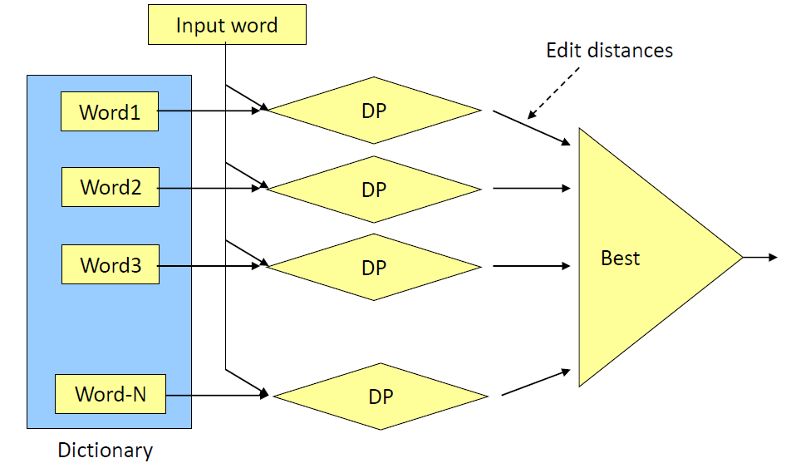
String Comparison
Select the word with lowest edit distance
Source: http://www.cs.cmu.edu/~bhiksha/courses/11-756.asr/spring2011/

Slide 16
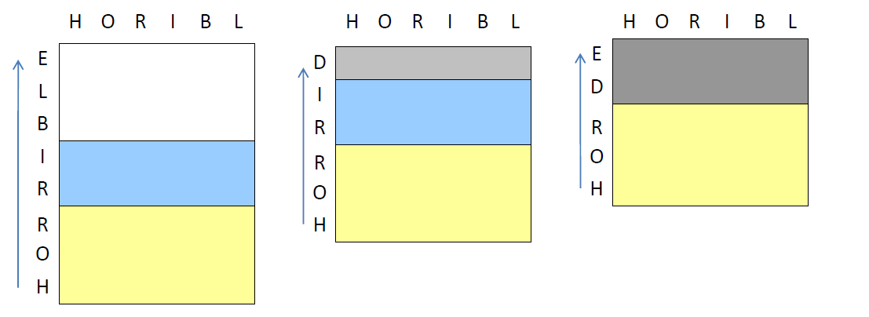
String Comparison
Trellis Sharing
Consider templates HORRIBLE, HORRID, HORDE being matched with HORIBL
Avoid duplication of computation -> Trellis Sharing

Slide 17
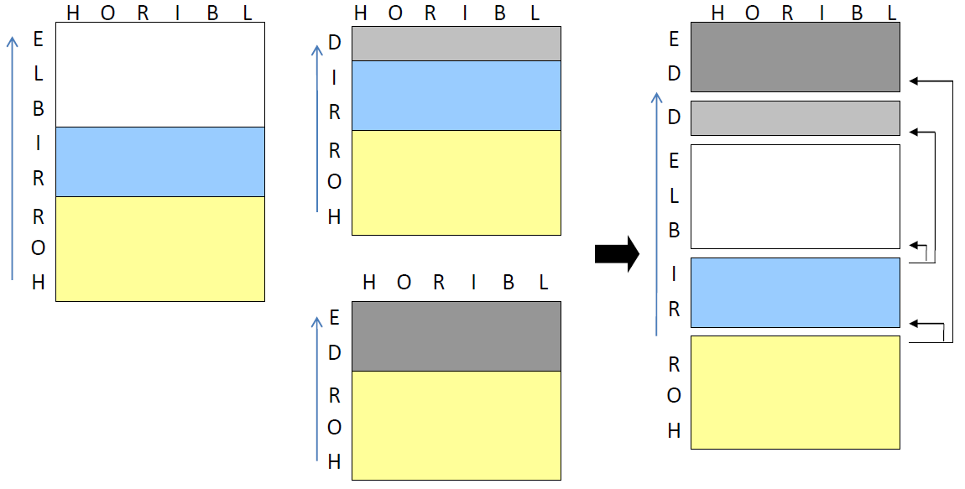
String Comparison
Trellis Sharing : Compute only the unique subsets(sub-trellises)
Source: http://www.cs.cmu.edu/~bhiksha/courses/11-756.asr/spring2011/

Slide 18
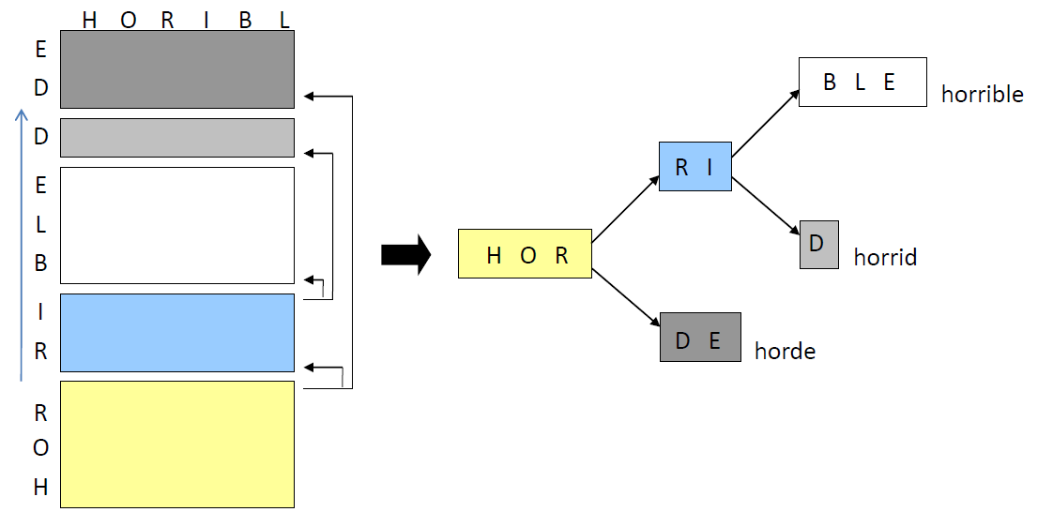
String Comparison : Trellis Sharing => Template sharing
Templates are fragmented, derive new template network to facilitate trellis sharing
Source: http://www.cs.cmu.edu/~bhiksha/courses/11-756.asr/spring2011/

Slide 19
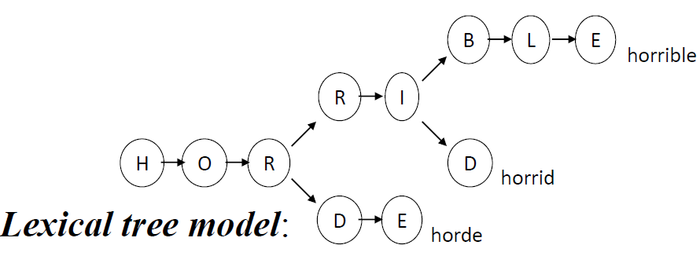
String Comparison : Trellis Sharing => Lexical Trees
We have to construct Trellis for the Lexical tree model
Source: http://www.cs.cmu.edu/~bhiksha/courses/11-756.asr/spring2011/

Slide 20
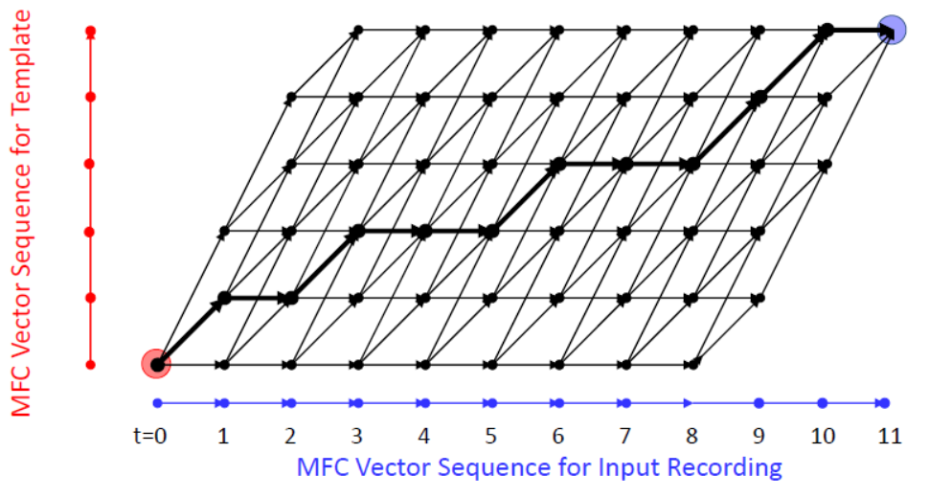
Dynamic Time warping(DTW)
This is done using Dynamic Time warping(DTW)

Slide 21
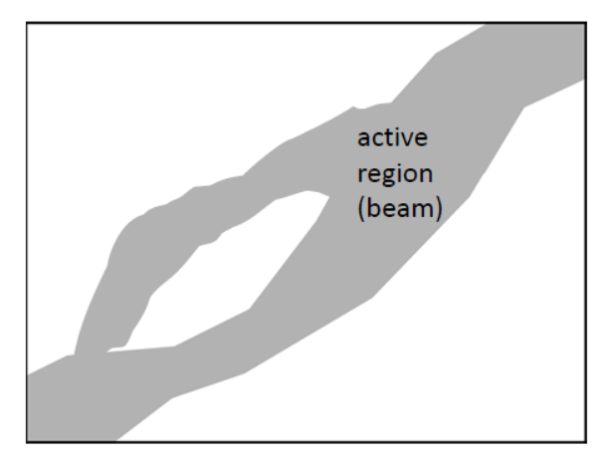
PRUNING

Slide 22
Approach
This problem can be resolved by doing all these comparisons in parallel.
We will skip the feature vector extraction part.
Strings will be arranged in a lexicon tree form which will represent the HMM.
Metric - run-time CPU vs FPGA.
HLS can also be used to convert the C code into Verilog

Slide 23
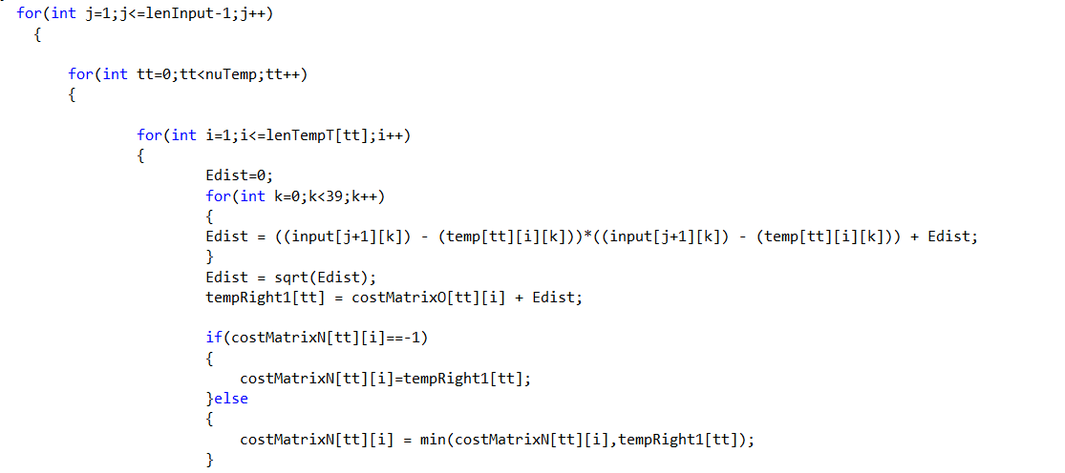
Approach
Lots of parallelism that can be exploited.
Complexity of implementing a C implemented algorithm in Verilog and see how much acceleration can be achieved.

Slide 24
Approach
First we will take a dictionary and convert it into a lexicon tree in ARM core. Then load it into BRAM.
User input will be taken using ARM core processor and that will further issue commands to PL for further comparison.
The dynamic time warping algorithm will be implemented in PL with advanced pruning and beam search techniques.
Will have to see how much data can be loaded in BRAM and how many parallel machines can be executed in one time. Will also have to explore the pipelining with ultimate aim to accelerate the throughput.

Slide 25
Naïve approach
SRAM
(template)
Processing
Unit
Edit distance
SRAM
(template)
Processing
Unit
Edit distance
Input word
SRAM
(template)
Processing
Unit
Edit distance
SRAM
(template)
Processing
Unit
Edit distance

Slide 26
Hardware block diagram ( tentatively )
SRAM
(template)
Communication Channel
Processing
Unit
SRAM
(template)
Processing
Unit
Input word
SRAM
(template)
Processing
Unit
SRAM
(template)
Processing
Unit
Tree structure contained here

Slide 27
Hardware Implementation - I
Input
BRAM
(Dictionary: Lexical Tree)
Processing
Unit
FIFO
queue
End of the tree
BRAM
(Output: Distances)
BRAM
(Trellis)
N such parallel units in FPGA

Slide 28
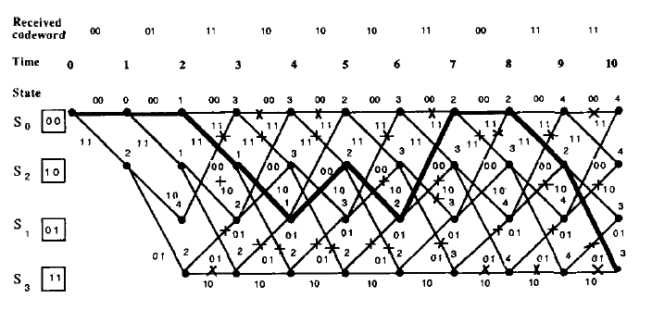
Hardware implementation – Viterbi decoder?
We might be able to adopt the well-established architecture for Viterbi decoder that has been used for communication for long
One crucial difference: There is no “Insertion”, “Deletion” in communication

Slide 29
Hardware Implementation - II
PROS:
N parallel units for disjoint lexical trees.
No scheduling conflict
CONS:
No Synchronization of events -> Pruning not possible
No Load sharing

Slide 30
Result expectation
Performance(Compute time) :
FPGA implementation is 2-4 orders better than the CPU
Similar work on DTW(dynamic time warping) by http://www.cs.ucr.edu/~mueen/pdf/icdm2010.pdf
Reported 4 orders of improvement over CPU

Slide 31
Figure of merits
Naive approach ( baseline )
By comparing the input word with all the word in dictionary
“Lexicon tree” let us put more words on our FPGA
Namely, by implementing Lexicon tree in FPGA, we can deal with more words in dictionary
(Figure of merits) = (size of dictionary with lexicon tree)/(size of dictionary in a naïve way)

Slide 32
Milestones
week | task
1 | Understand the complete C implementation and lexical tree structure
2 | Create lexical tree and store it in BRAM
3 | Create DTW structure in FPGA using Verilog/HLS
4 | Continuation of week3
5 | Compare results with processor
6 | Make implementation user friendly so can be used and displayed in real-time

Slide 33
Risk Assessment
Hardware resources can be a constraint
Implementation of Pipeline
Will be accessed after understanding the C implementation completely will be able to assess.

Slide 34
THANK YOU

